Slide 1
In order to participate in the second study you must first complete a short sorting process. You will now be presented with several questions in which you will need to mark your preferences and opinions. According to these preferences, you will be assigned to one of two groups: we will refer to these groups as YOUR GROUP and the OTHER GROUP.
Previous studies show that there is a 50%-50% divide based on these preferences.

Slide 2
You have been assigned to one of the groups.
We will refer to these groups as
YOUR GROUP and THE OTHER GROUP
Next is the explanation of the actual study.

Slide 3
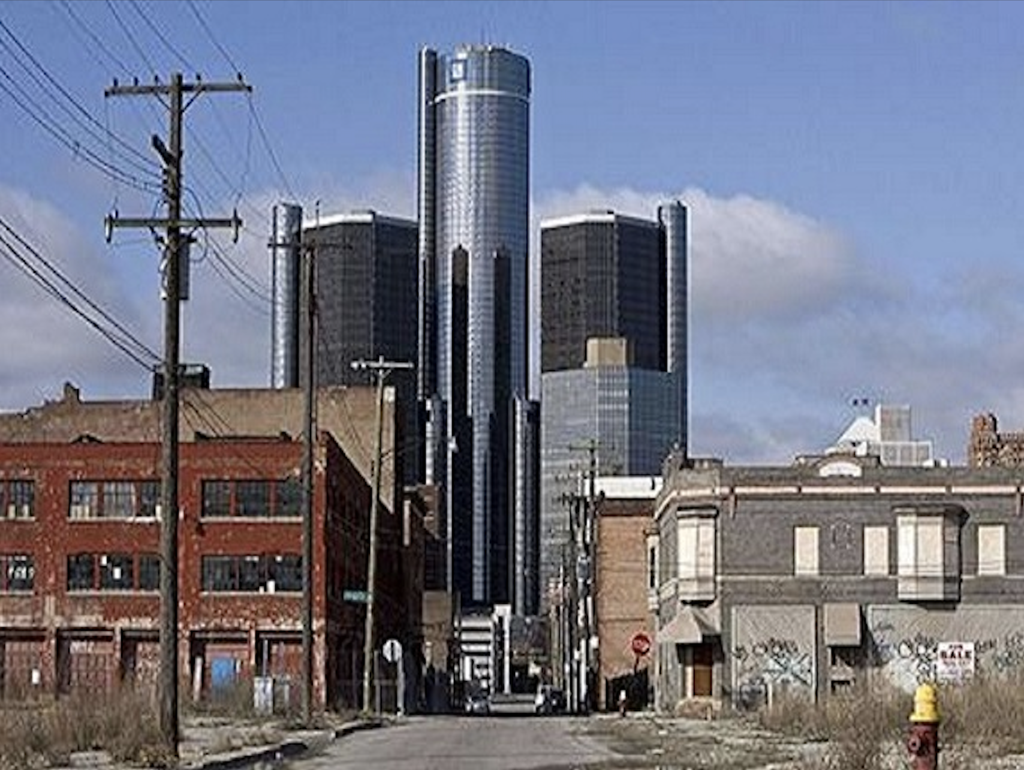
In this study you will first observe a picture on a screen that looks like the one below. The picture will appear on the screen for 5 seconds.

Slide 4
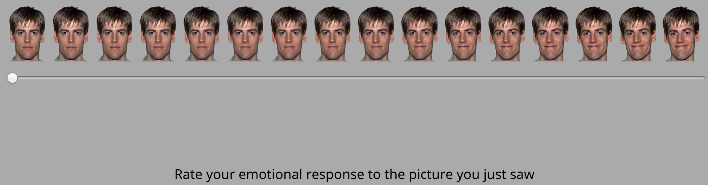
​Following the picture, a scale will appear in the middle of the screen. By moving the scale, you are asked to rate your emotional response to the picture you just saw. You have to move the scale and click on it in order to move to the next page. Once you click the scale, it will move to the next page.

Slide 5
Remember, the goal here is to click one point on the scale that reflects YOUR EMOTIONAL RESPONSE to the picture you just saw.

Slide 6
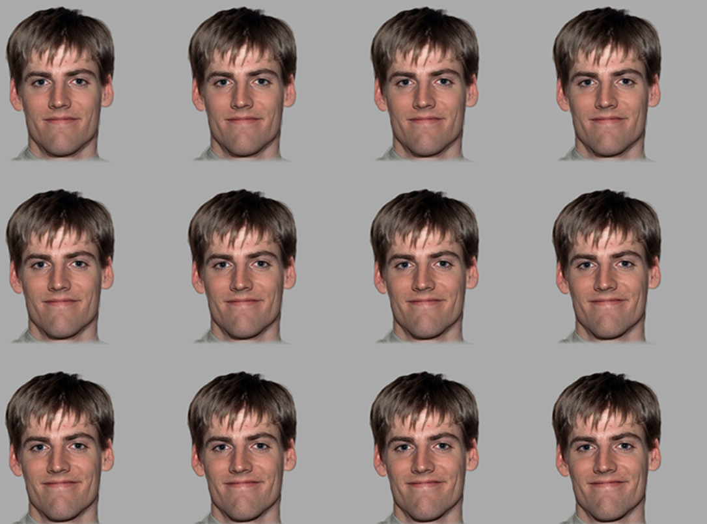
Once you make the choice, the page will switch to the next trial.

Slide 7

Following these pictures you will then asked to choose whether these 12 ratings were taken from YOUR GROUP or from the OTHER GROUP. Use the mouse to choose the group from which these responses were taken?

Slide 8
Next you will conduct a short practice run for the task.
Please don't hesitate to ask the experimenter any questions regarding the study.

Slide 9
Thank you for completing the practice stage.
Remember – the goal was to reflect YOUR EMOTIONAL RESPONSE of the picture you just saw.
In the following section you will complete the actual study, which consists of 50 trials. The task should take 5 minutes, more or less.
Click ‘Continue’ to begin the actual task.

Slide 10
You've completed the task.
Thank you for your participation.
The next section is a short survey
(up to 5 min).

